Slide 1
Networking on the Cloud
Dr. Leon Jololian

Slide 2
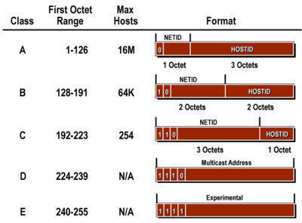
IP Classes
The Internet is laid out as Class A, B, C, D, and E.
Class A uses up the first half of the entire Internet.
Class B uses half of the remaining half.
Class C uses the remaining half again.
Class D (Multicasting) uses up the remaining half again.
Whatever is left over is reserved for Class E.

Slide 3
Class A Addresses
ARIN (American Registry for Internet Numbers)
Class A: All addresses have their first octet between 1 to 126. (0 and 127 are reserved)
Class A subnets are all 24 bits long, which means the subnet mask is only 8 bits long.
For example, we have the entire 3.0.0.0/8 subnet owned by GE (16.8 million addresses).
The U.S. Army owns 6.0.0.0/8.
Level 3 Communications owns 8.0.0.0/8.
IBM owns 9.0.0.0/8.
AT&T owns 12.0.0.0/8, Xerox owns 13.0.0.0/8, HP owns 15.0.0.0/8 and 16.0.0.0/8, and Apple owns 17.0.0.0/8.

Slide 4
Class B Addresses
All Class B addresses have their first octet between 128 and 191.
Class B subnets are all 16 bits long, which means the subnet masks are 16 bits long (64K addresses).
For example, BBN Communications owns 128.1.0.0/16, which is 128.1.0.0 to 128.1.255.255.
Carnegie Mellon University owns 128.2.0.0/16.

Slide 5
Class C Addresses
All Class C addresses have their first octet between 192 and 223.
Class C subnets are all 8 bits long, so the subnet mask is 24 bits long (254 addresses).
ARIN (the organization that assigns Internet addresses) will sell blocks of four Class C addresses only to individual companies and you have to really justify why you need 1,024 Public IP addresses.
If you need to run BGP so you can use multiple ISPs for redundancy, you have to have your own block of IP addresses.
You have to pay an annual fee for your block of 1,024 addresses with a subnet mask of /22, or 255.255.252.0.

Slide 6
Public vs. Private IP Addresses
Besides the reserved IP addresses (0.0.0.0/8 and 127.0.0.0/8), there are other addresses not used on the public Internet.
These private subnets consist of private IP addresses and are usually behind a firewall or router that performs NAT (network address translation).
NAT is needed because private IP addresses are non-routable on the public Internet, so they must be translated into public IP addresses before they touch the Internet.
Private IPs are never routed because no one really owns them. And since anyone can use them, there's no right place to point a private IP address to on the public Internet.
Private IP addresses are used in most LAN and WAN environments.

Slide 7
Blocks of IP addresses allocated for private networks:
10.0.0.0/8 (10.0.0.0 to 10.255.255.255)
172.16.0.0/12 (172.16.0.0 to 172.31.255.255)
192.168.0.0/16 (192.168.0.0 to 192.168.255.255)
169.254.0.0/16 (169.254.0.0 to 169.254.255.255)
Note that 169.254.0.0/16 is a block of private IP addresses used for random self IP assignment where DHCP servers are not available.
10.0.0.0/8 is normally used for larger networks, since there are approximately 16.8 million IP addresses available within that block. They chop it up into lots of smaller groups of subnets for each geographic location, which are then subdivided into even smaller subnets.
Smaller companies typically use the 172.16.0.0/12 range, chopped up into smaller subnets, although there's no reason they can't use 10.0.0.0/8 if they want to.
Home networks typically use a /24 subnet within the 192.168.0.0/16 subnet.

Slide 8
The use of private IP addresses and NAT has prolonged the life of IPv4 for the foreseeable future because it effectively allows a single public IP address to represent thousands of private IP addresses.
At the current rate that IPv4 addresses are handed out, we have enough IPv4 addresses for over 10 years.
ARIN is much more stingy now about handing them out, and small blocks of IP addresses are relatively expensive
The next version of IP addresses, called IPv6, is 128 bits long—and there are more than 79 thousand trillion trillion times more IP addresses than IPv4.
Even if we assigned 4.3 billion people on the planet with 4.3 billion IP addresses each, we would still have more than 18 million trillion IPv6 addresses left!

Slide 9
Virtual Networks
Virtual networks enable secure network connections between virtual machines, the internet, and other services such as SQL database.
Virtual networks are broken down into logical segments called subnets.
Subnets are used to control network flow, and as a security boundary.
When deploying a VM, it generally includes a virtual network interface attached to a subnet.
Later, we will create a single virtual network with two subnets:
a front-end subnet for hosting a web application, and
a back-end subnet for hosting a database server.

Slide 10
The Subnet Mask
The beginning number is the "Network ID" and the ending number is the "Broadcast ID.“
When creating subnets, we can't arbitrarily pick the beginning and ending IP’s.
The subnet mask determines:
the size of a subnet, and
the end points on the subnet.
It's called a "subnet mask" because it masks out the host bits and leaves only the Network ID that begins the subnet.
Once you know the beginning of the subnet and how big it is, you can determine the end of the subnet, which is the Broadcast ID.
Subnet ID = (any host IP within subnet) AND (Subnet Mask)

Slide 11


Computing the Subnet ID
IP
Subnet Mask
Subnet ID
IP
Subnet Mask
Subnet ID

Slide 12
Subnet Mask
A subnet mask contains four bytes (32 bits) and is often written using the same "dotted-decimal" notation.
For example, a very common subnet mask in its binary representation:
11111111 11111111 11111111 00000000
typically shown in the equivalent, more readable form
255.255.255.0
All valid subnet masks contain two parts:
extended network portion: the left side with all mask bits set to ‘1’, and
host portion: the right side with all bits set to '0.

Slide 13
A subnet mask is a delineation between the network portion and the host portion. Subnetting works by applying the concept of extended network addresses to individual network devices.
An extended network address includes both a network address and additional bits that represent the subnet number.
The network address and subnet number, when combined with the host address, implement a three-level scheme.

Slide 14
Example
Assume we have Class A network:
IP Address: 10.0.0.0
Subnet Mask: 255.0.0.0
This allows us to have 2⁸⁺⁸⁺⁸ Host IPs (16,777,216)
For Class B network:
IP Address: 178.26.0.0
Subnet Mask: 255.255.0.0
2⁸⁺⁸ Host IPs (65,536)
For Class C network:
IP Address: 210. 188.1.0
Subnet Mask: 255.255.255.0
2⁸ Host IPs (256)

Slide 15
What are the limitations of this scheme?
With a Class A, we can have a network with up to 2²⁴ IPs. This can introduce too much chatter on the network and have some security implications.
Solution: Take a relatively big address space and break it up into smaller subnets.
Implementation: instead of using all the bits of the host bits, we borrow some of the host bits and turn them into network bits.
For example, for a Class A network (e.g. IP = 10.0.0.0), by using a subnet mask of 255.255.255.0, we’ll have:
255. 255. 255. 0 2^{S} subnets
Network S = Subnet H = Host 2^{H} hosts
bits bits bits

Slide 16
For any host IP and a subnet mask, we should be able to find:
What is the network address?
What is the broadcast address?
How many subnets are there?
How many hosts per subnet are there?
As we take bits away from the host and turn them into network bits, we have to do so in consecutive order starting from the higher order bits.
A B C D E
128 192 224 240 248 252 254 255
128 64 32 16 8 4 2 1
2⁷ 2⁶ 2⁵ 2⁴ 2³ 2² 2¹ 2⁰

Slide 17
Example-1
10.15.67.129 (IP)
255.255.255.192 (Subnet Mask)
Based on the subnet mask, we have 8 bits (1st octet) + 8 bits (2nd octet) + 8 bits (3rd octet) + 2 bits (4th octet) = 26 bit network address.
Since we have a Class A IP (why?), we can further divide the 26 bit network address into: 8 bit network address + 18 bit subnet address.
The size of the subnet will be determined by the remaining 6 bits of the 4th octet. Therefore, we have 2⁶ (64) host IPs/subnet.
The subnets delineations are: 0-63, 64-127, 128-191, 192-255.

Slide 18
By convention, the first IP of a subnet is used as the network address, and the last IP of a subnet is used as the broadcast address.
For this example, 0, 64, 128, 192 are the network addresses, and 63, 127, 191, 255 are the broadcast addresses, within their respective subnets.
In summary, we have
This is a Class A network
2¹⁸ subnets (262,144)
64 IPs per subnet (but only 62 host IPs)
Regarding our subnet (to which 10.15.67.129 belongs):
The subnet ID is 10.15.67. 128
The broadcast IP is 10.15.67.191

Slide 19
Example-2
200.168.144.132 (IP)
255.255.255.224 (Subnet Mask)
Based on the subnet mask, we have 8 bits (1st octet) + 8 bits (2nd octet) + 8 bits (3rd octet) + 3 bits (4th octet) = 27 bit network address.
Since we have a Class C IP, we can further divide the 27 bit network address into: 24 bit network address + 3 bit subnet address.
The size of the subnet will be determined by the remaining 5 bits of the 4th octet. Therefore, we have 2⁵ (32) host IPs/subnet.
The subnets delineations are: 0-31, 32-63, 64-95, 96-127, 128-159, 160-191, 192-223, 224-255.

Slide 20
For this example, 0, 32, 64, 96, 128, 160, 192, 224 are the network addresses, and 31, 63, 95, 127, 159, 191, 223, 255 are the broadcast addresses, within their respective subnets.
In summary, we have
This is a Class C network
2³ subnets (8)
32 IPs per subnet (but only 30 host IPs)
Regarding our subnet (to which 200.168.144.132 belongs):
The subnet ID is 200.168.144.128
The broadcast IP is 10.15.67.159

Slide 21
Example-3
160.123.34.80 (IP)
255.255.248.0 (Subnet Mask)
Based on the subnet mask, we have 8 bits (1st octet) + 8 bits (2nd octet) + 5 bits (3rd octet) = 21 bit network address.
Since we have a Class B IP, we can further divide the 21 bit network address into: 16 bit network address + 5 bit subnet address.
The size of the subnet will be determined by the remaining 3 bits of the 3rd octet and the 8 bits of the 4th octet. Therefore, we have 2¹¹ (2,048) host IPs/subnet.
The subnets delineations are: 0-7, 8-15, 16-23, 24-31, 32-39, 40-47, 48-55, 56-63, 64-71, 72-79, 80-87, 88-95, 96-103, 104-112, 112-119, 120-127, 128-135, 136-143, 144-151, 152-159, 160-167, 168-175, 176-183, 184-191, 192-199, 200-207, 208-215, 216-223, 224-231, 232-239, 240-247, 248-255.

Slide 22
For this example, 0, 8, 16, 24, 32, 40, 48, 56, 64, 72, …, 248 are the network addresses, and 7, 15, 23, 31, 39, 47, 55, 63, 71, 79, …, 255 are the broadcast addresses, within their respective subnets.
In summary, we have
This is a Class B network
2⁵ subnets (32)
2¹¹ IPs per subnet (2048 IPs)
Regarding our subnet (to which 200.168.144.132 belongs):
The subnet ID is 160.123.32.0
The broadcast IP is 160.123.39.255

Slide 23
Real World Example
A small business plans to use the 192.168.1.0 network
1100 0000 . 1010 1000 . 0000 0001 . 0000 0000
for its internal (intranet) hosts.
The human resources department wants their computers to be on a restricted part of this network because they store payroll information and other sensitive employee data.
Because this is a Class C network, the default subnet mask of 255.255.255.0 allows all computers on the network to be peers (to send messages directly to each other) by default.

Slide 24
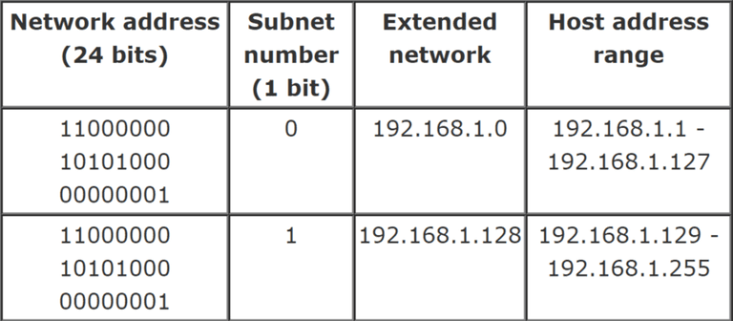
The first four bits of 192.168.1.0 (11000000. x.x.x) are 1100.
This places the network in the Class C range.
It also fixes the length of the network address at 24 bits.
For instance, by using a 25-bit mask 255.255.255.128, we can
create a two-subnet network:

Slide 25
Another Example
An administrator has a 192.168.1.0/24 network.
The suffix /24 tells the number of bits used for network address.
In this example, the administrator has three different departments with different number of hosts: Sales department has 100 computers, Purchasing department has 50 computers, Accounting has 25 computers, and Management has 5 computers.
In CIDR, the subnets are of fixed size. Using the same methodology the administrator cannot fulfill all the requirements of the network.

Slide 26
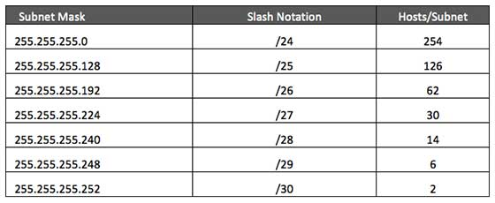
Step - 1
A list of possible Subnets:

Slide 27
Step - 2
Sort the requirements of IPs in descending order (Highest to Lowest):
Sales 100
Purchase 50
Accounts 25
Management 5

Slide 28
Step - 3
We start by allocating the highest range of IPs to the highest requirement.
So let's assign 192.168.1.0 /25 (255.255.255.128) to the Sales department.
This IP subnet with Network number 192.168.1.0 has 126 valid Host IP addresses which satisfy the requirement of the Sales department.
The subnet mask used for this subnet has 10000000 as the last octet.

Slide 29
Step - 4
Allocate the next highest range, 192.168.1.128 /26 (255.255.255.192), to the Purchase department.
This IP subnet with Network number 192.168.1.128 has 62 valid Host IP Addresses which can be easily assigned to all the PCs of the Purchase department.
The subnet mask used has 11000000 in the last octet.

Slide 30
Step - 5
Now, we allocate the next highest range, i.e. Accounts.
The requirement of 25 IPs can be fulfilled with 192.168.1.192 /27 (255.255.255.224) IP subnet, which contains 30 valid host IPs.
The network number of Accounts department will be 192.168.1.192.
The last octet of subnet mask is 11100000.

Slide 31
Step - 6
Finally, we allocate the next highest range to Management.
The Management department contains only 5 computers.
The subnet 192.168.1.224 /29 with the Mask 255.255.255.248 has exactly 6 valid host IP addresses.
So this can be assigned to Management.
The last octet of the subnet mask will contain 11111000.

Slide 32
Web Hosting with a Secure Backend
Assume that we are hosting a web application with a database in the back-end.
We will deploy two virtual machines and configure the networking for these VMs.
To do tasks:
Create a virtual network and subnet
Create a public IP address
Create a front-end VM
Secure network traffic
Create a back-end VM

Slide 33
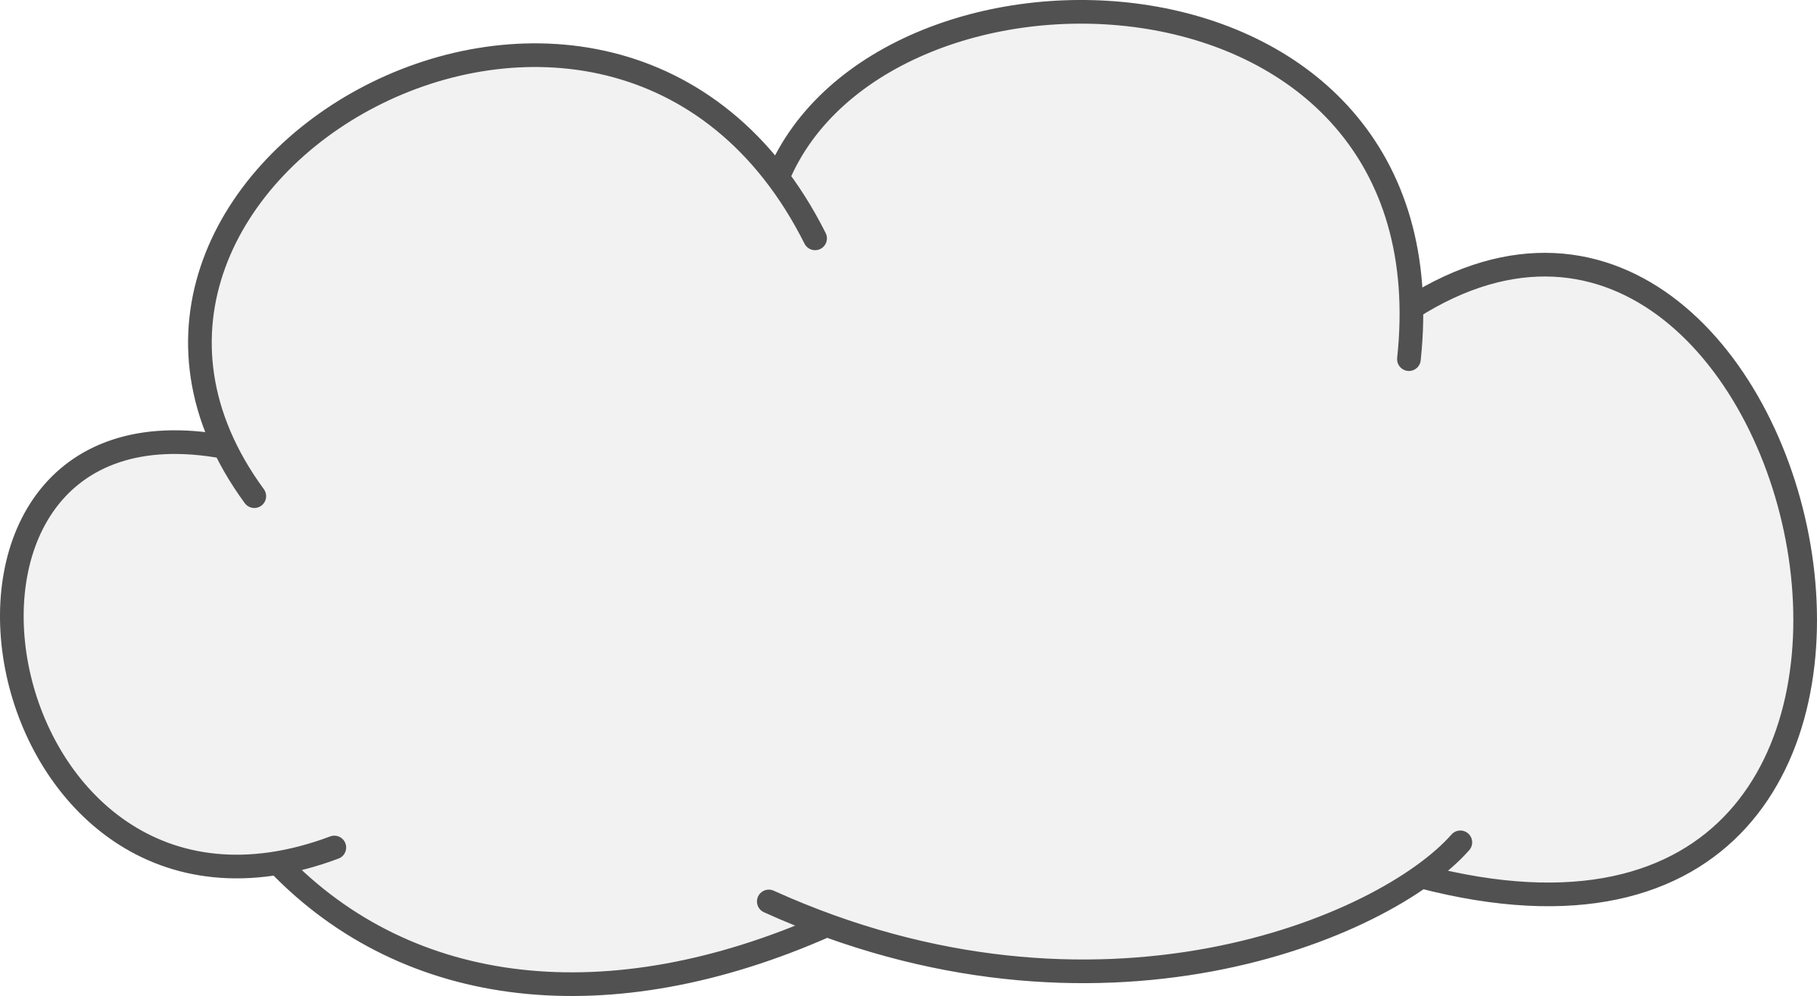

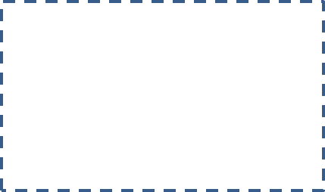


Subnet 2 (NSG-2)
Subnet 1 (NSG-1)
Web Server
Database Server
Public IP
Virtual Network
The Cloud
Client

Slide 34
Virtual Network (myVNet): The virtual network that the VMs use to communicate with each other and the internet.
Subnet 1 (myFrontendSubnet): The subnet in myVNet used by the front-end resources.
Public IP (myPublicIPAddress): The public IP address used to access myFrontendVM from the internet.
(myFrontentNic): The network interface used by myFrontendVM to communicate with myBackendVM.
Web Server (myFrontendVM): The VM used to communicate between the internet and myBackendVM.
NSG-2: (myBackendNSG): The network security group that controls communication between the Webserver and Database Server.
Subnet 2 (myBackendSubnet): The subnet associated with NSG-2 and used by the back-end resources.
(myBackendNic): The network interface used by Database Server to communicate with Web Server.
Database Server (myBackendVM): The VM that uses port 22 and 3306 to communicate with Web Server.

Slide 35
Create a resource group:
az group create --name myRGNetwork --location eastus
Create virtual network:
az network vnet create \
--resource-group myRGNetwork \
--name myVNet \
--address-prefix 10.0.0.0/16 \
--subnet-name myFrontendSubnet \
--subnet-prefix 10.0.1.0/24
Create a subnet:
az network vnet subnet create \
--resource-group myRGNetwork \
--vnet-name myVNet \
--name myBackendSubnet \
--address-prefix 10.0.2.0/24

Slide 36
Create a public IP address:
az network public-ip create --resource-group myRGNetwork --name myPublicIPAddress
Change allocation method
The IP address allocation method can be changed using the az network public-ip update command. In this example, the IP address allocation method of the front-end VM is changed to static.
First, deallocate the VM:
az vm deallocate --resource-group myRGNetwork --name myFrontendVM
Use the az network public-ip update command to update the allocation method. In this case, the --allocation-method is being set to static.
az network public-ip update --resource-group myRGNetwork --name myPublicIPAddress --allocation-method static
Start the VM:
az vm start --resource-group myRGNetwork --name myFrontendVM --no-wait

Slide 37
No public IP address
Often, a VM does not need to be accessible over the internet. To create a VM without a public IP address, use the --public-ip-address "" argument with an empty set of double quotes. This configuration is demonstrated later.
Create a front-end VM:
az vm create \
--resource-group myRGNetwork \
--name myFrontendVM \
--vnet-name myVNet \
--subnet myFrontendSubnet \
--nsg myFrontendNSG \
--public-ip-address myPublicIPAddress \
--image UbuntuLTS \
--generate-ssh-keys

Slide 38
Secure network traffic
A network security group (NSG) contains a list of security rules that allow or deny network traffic to resources connected to Virtual Networks (VNet).
NSGs can be associated to subnets or individual network interfaces.
When an NSG is associated with a network interface, it applies only the associated VM.
When an NSG is associated to a subnet, the rules apply to all resources connected to the subnet.

Slide 39
Network security group rules
NSG rules define networking ports over which traffic is allowed or denied.
The rules can include source and destination IP address ranges so that traffic is controlled between specific systems or subnets.
NSG rules also include a priority (between 1—and 4096). Rules are evaluated in the order of priority. A rule with a priority of 100 is evaluated before a rule with priority 200.
All NSGs contain a set of default rules. The default rules cannot be deleted, but because they are assigned the lowest priority, they can be overridden by the rules that you create.
The default rules for NSGs are:
Virtual network - Traffic originating and ending in a virtual network is allowed both in inbound and outbound directions.
Internet - Outbound traffic is allowed, but inbound traffic is blocked.
Load balancer - Allow Azure’s load balancer to probe the health of your VMs and role instances. If you are not using a load balanced set, you can override this rule.

Slide 40
Create network security groups
A network security group can be created at the same time as a VM using the az vm create command.
When doing so, the NSG is associated with the VMs network interface and an NSG rule is auto created to allow traffic on port 22 from any source.
Earlier, the front-end NSG was auto-created with the front-end VM. An NSG rule was also auto created for port 22.
In some cases, it may be helpful to pre-create an NSG, such as when default SSH rules should not be created, or when the NSG should be attached to a subnet.
Use the az network nsg create command to create a network security group:
az network nsg create --resource-group myRGNetwork --name myBackendNSG

Slide 41
Instead of associating the NSG to a network interface, it is associated with a subnet. In this configuration, any VM that is attached to the subnet inherits the NSG rules.
Update the existing subnet named myBackendSubnet with the new NSG.
az network vnet subnet update \
--resource-group myRGNetwork \
--vnet-name myVNet \
--name myBackendSubnet \
--network-security-group myBackendNSG

Slide 42
Secure incoming traffic:
When the front-end VM was created, an NSG rule was created to allow incoming traffic on port 22. This rule allows SSH connections to the VM. For this example, traffic should also be allowed on port 80. This configuration allows a web application to be accessed on the VM.
Use the az network nsg rule create command to create a rule for port 80.
az network nsg rule create \
--resource-group myRGNetwork \
--nsg-name myFrontendNSG \
--name http \
--access allow \
--protocol Tcp \
--direction Inbound \
--priority 200 \
--source-address-prefix "*" \
--source-port-range "*" \
--destination-address-prefix "*" \
--destination-port-range 80

Slide 43
The front-end VM is only accessible on port 22 and port 80.
All other incoming traffic is blocked at the network security group. It may be helpful to visualize the NSG rule configurations. Return the NSG rule configuration with the az network rule list command:
az network nsg rule list --resource-group myRGNetwork --nsg-name myFrontendNSG --output table
Secure VM to VM traffic
Network security group rules can also apply between VMs. For this example, the front-end VM needs to communicate with the back-end VM on port 22 and 3306.
This configuration allows SSH connections from the front-end VM, and also allow an application on the front-end VM to communicate with a back-end MySQL database. All other traffic should be blocked between the front-end and back-end virtual machines.

Slide 44
Use the az network nsg rule create command to create a rule for port 22.
Notice that the --source-address-prefix argument specifies a value of 10.0.1.0/24.
This configuration ensures that only traffic from the front-end subnet is allowed through the NSG:
az network nsg rule create \
--resource-group myRGNetwork \
--nsg-name myBackendNSG \
--name SSH \
--access Allow \
--protocol Tcp \
--direction Inbound \
--priority 100 \
--source-address-prefix 10.0.1.0/24 \
--source-port-range "*" \
--destination-address-prefix "*" \
--destination-port-range "22"

Slide 45
Now add a rule for MySQL traffic on port 3306:
az network nsg rule create \
--resource-group myRGNetwork \
--nsg-name myBackendNSG \
--name MySQL \
--access Allow \
--protocol Tcp \
--direction Inbound \
--priority 200 \
--source-address-prefix 10.0.1.0/24 \
--source-port-range "*" \
--destination-address-prefix "*" \
--destination-port-range "3306"

Slide 46
Finally, because NSGs have a default rule allowing all traffic between VMs in the same VNet, a rule can be created for the back-end NSGs to block all traffic.
Notice here that the --priority is given a value of 300, which is lower that both the NSG and MySQL rules. This configuration ensures that SSH and MySQL traffic is still allowed through the NSG:
az network nsg rule create \
--resource-group myRGNetwork \
--nsg-name myBackendNSG \
--name denyAll \
--access Deny \
--protocol Tcp \
--direction Inbound \
--priority 300 \
--source-address-prefix "*" \
--source-port-range "*" \
--destination-address-prefix "*" \
--destination-port-range "*"

Slide 47
Create back-end VM
Now create a virtual machine, which is attached to the myBackendSubnet.
Notice that the --nsg argument has a value of empty double quotes. An NSG does not need to be created with the VM. The VM is attached to the back-end subnet, which is protected with the pre-created back-end NSG.
This NSG applies to the VM. Also, notice here that the --public-ip-address argument has a value of empty double quotes. This configuration creates a VM without a public IP address.
az vm create \
--resource-group myRGNetwork \
--name myBackendVM \
--vnet-name myVNet \
--subnet myBackendSubnet \
--public-ip-address "" \
--nsg "" \
--image UbuntuLTS \
--generate-ssh-keys

Slide 48
The back-end VM is only accessible on port 22 and port 3306 from the front-end subnet.
All other incoming traffic is blocked at the network security group.
It may be helpful to visualize the NSG rule configurations. Return the NSG rule configuration with the az network rule list command:
az network nsg rule list --resource-group myRGNetwork --nsg-name myBackendNSG --output table

